Slide 1
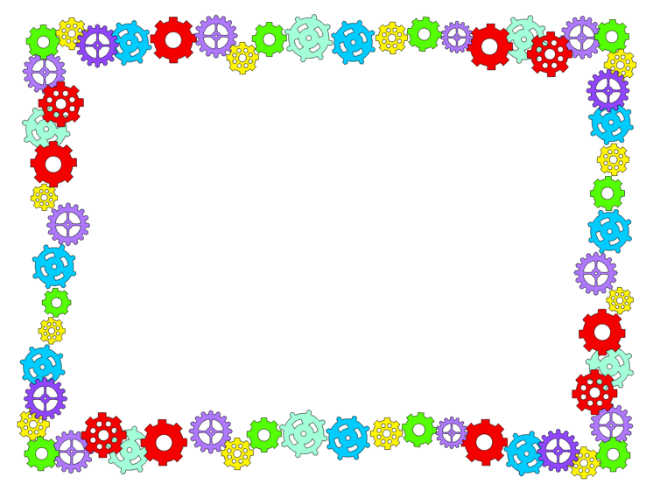
Sequencing Events with BeeBots
Objective: I can sequence the events in a story.
Materials:
Read Aloud with a journey involved (ex. We're Going on a Bear Hunt or Rosie's Walk, Construction paper, Sequence cards, BeeBots
Procedure:
Read Rosie's Walk by Pat Hutchins or another book with a journey involved.
After reading, construct a Bee-Bot mat that includes the different Collaboratively retell the story and agree the sequence of moves Bee-Bot will need to make to follow the same path followed in the story.
Place the Bee-Bots on the mat and see if they can follow the path correctly.
Assessment:
Use a simple checklist or rubric:
We placed the sequence cards in order: ALL SOME NONE
We programmed the BeeBot to follow the path correctly: YES SOME NO
Based on lesson from: http://tinyurl.com/yankgyds

Slide 2
Creative Dramatics with Legos
Objective: I can participate in creative dramatics.
Materials:
The Most Magnificent Thing by Ashley Spires
Procedure:
Read The Most Magnificent Thing. Discuss what made her most magnificent thing so magnificent. Ask students to brainstorm what “magnificent” thing they would build for our playground.
Have students build that item using K’nex.
Assessment:
Use a simple checklist or rubric

Slide 3
Creating a Setting with Legos
Objective: I can identify the setting of a story.
Materials:
Oh No! by Candace Fleming Legos
Procedure:
Read the book Oh No! by Candace Fleming.
Discuss the characters, setting and important events.
Create the setting of the story out of legos
Assessment:
Use a simple checklist or rubric

Slide 4
Retelling with Playdough
Objective: I can retell the important events in a story.
Materials:
Scaredy Squirrel at the Beach by Melanie Watts Playdough Beach Mats
Procedure:
Read the book Scaredy Squirrel at the Beach by Melanie Watts.
Discuss the characters, setting and important events.
Create details to the story using playdough and Expo markers on printed mats
Assessment:
Use a simple checklist or rubric

Slide 5
